Slide 1
Module 5
Presentation Layer & Application Layer

Slide 2
Presentation layer :
Compression: Comparison between Lossy Compression and Lossless Compression,
Huffman Coding
Speech Compression
LZW
RLE
Image Compression – GIF,JPEG.

Slide 3
Application layer:
Standard Client-Server Protocols:
World Wide Web,
HTTP
FTP
Electronic Mail
Domain Name System (DNS)
SNMP

Slide 4
The Application Layer is topmost layer in the Open System Interconnection (OSI) model.
This layer also makes a request to its bottom layer, which is presentation layer for receiving various types of information from it.
The Application Layer interface directly interacts with application and provides common web application services.
This layer is basically highest level of open system, which provides services directly for application process.

Slide 5
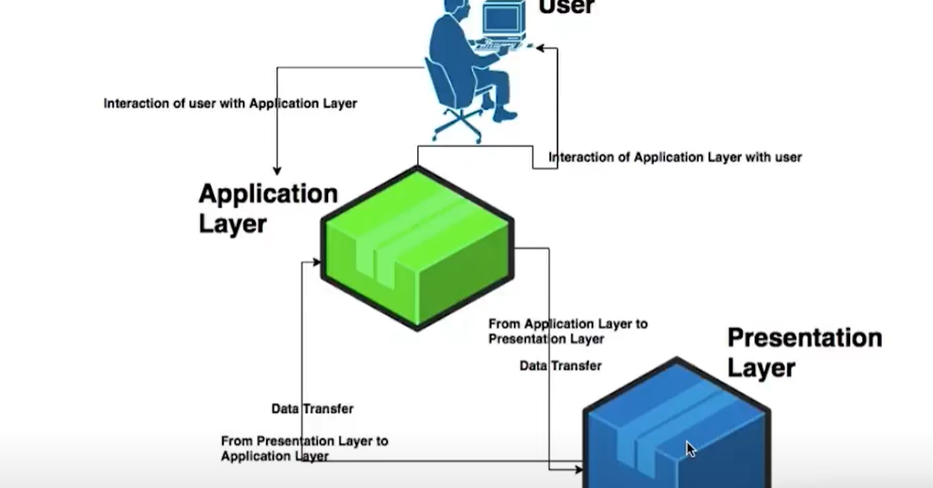

Slide 6
Functionalities of application layer:
Only layer that interacts with user and application
Actual request for any kind of data input and output processes are initiated at application layer.
Application layer interacts with the presentation layer
Application layer ensures that both the communicating host are present at both the ends of the channel for communication to happen
Ensures that actual media is present for communication to happen
Decides which protocol is used for communicating host
Provides interface between two communicating applications
Ensures error recovery and data integrity checks
Authentication services run on application layer

Slide 7
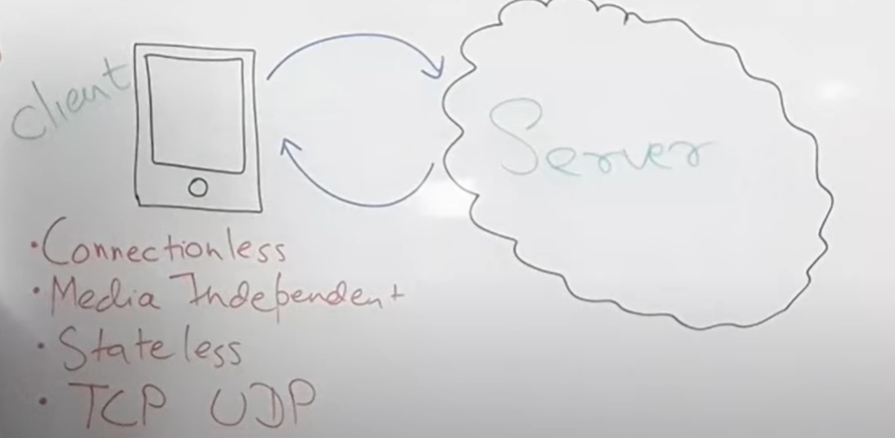
HTTP Protocol

Slide 8
There are three basic features that make HTTP a simple but powerful protocol:
HTTP is connectionless: The HTTP client, i.e., a browser initiates an HTTP request and after a request is made, the client waits for the response. The server processes the request and sends a response back after which client disconnect the connection. So client and server knows about each other during current request and response only. Further requests are made on new connection like client and server are new to each other.
HTTP is media independent: It means, any type of data can be sent by HTTP as long as both the client and the server know how to handle the data content.
HTTP is stateless: As mentioned above, HTTP is connectionless and it is a direct result of HTTP being a stateless protocol. The server and client are aware of each other only during a current request. Afterwards, both of them forget about each other. Due to this nature of the protocol, neither the client nor the browser can retain information between different requests across the web pages.

Slide 9
HTTP Version
HTTP/1.0
HTTP/1.1

Slide 10
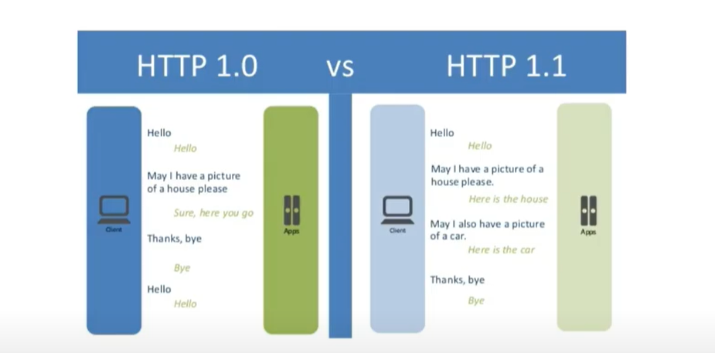

Slide 11
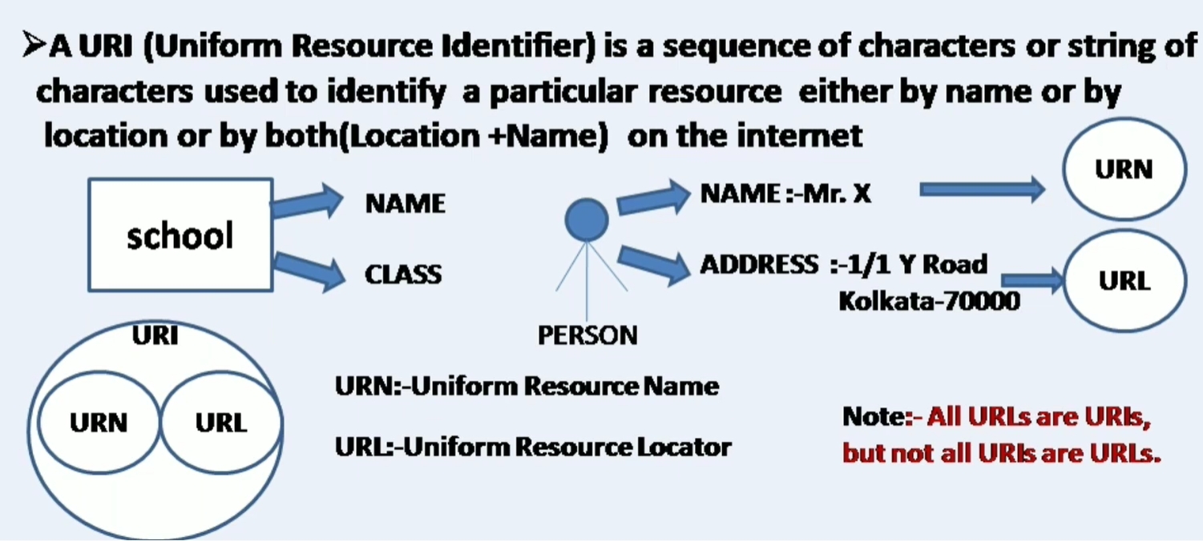

Slide 12
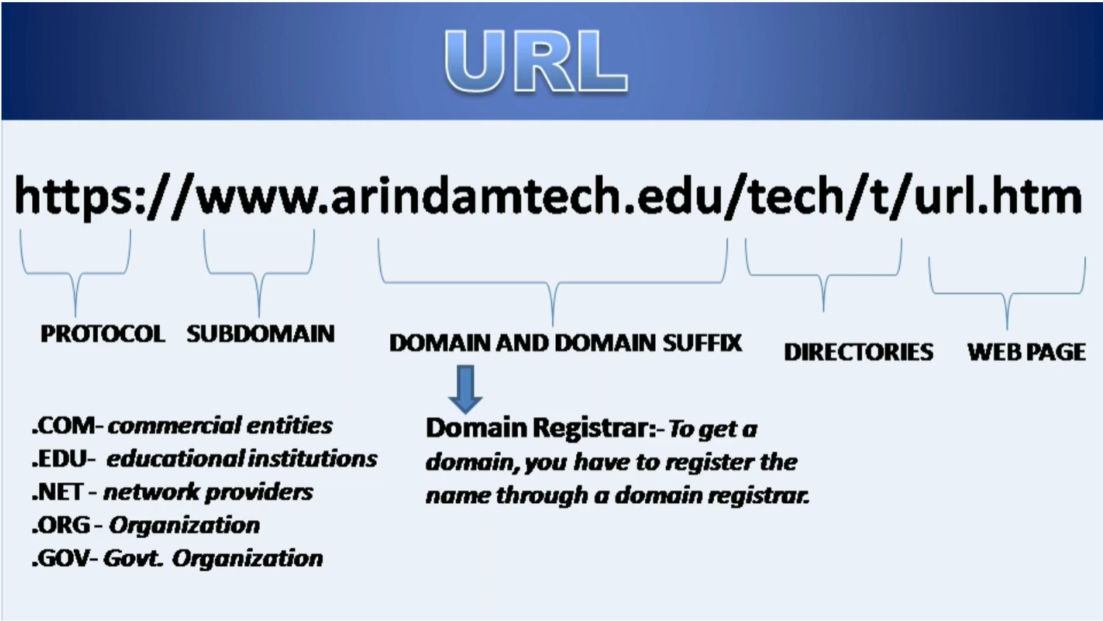

Slide 13
HTTP makes use of the Uniform Resource Identifier (URI) to identify a given resource and to establish a connection. Once the connection is established, HTTP messages are passed in a format similar to that used by the Internet mail
These messages include requests from client to server and responses from server to client which will have the following format:
HTTP requests and HTTP responses use a generic message format of for transferring the required data. This generic message format consists of the following four items.

Slide 14
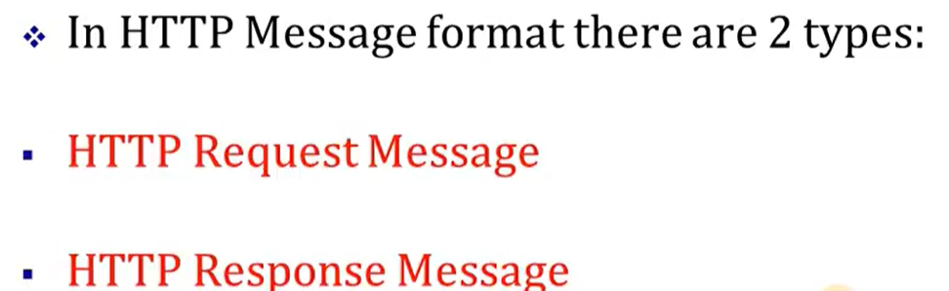
HTTP message

Slide 15
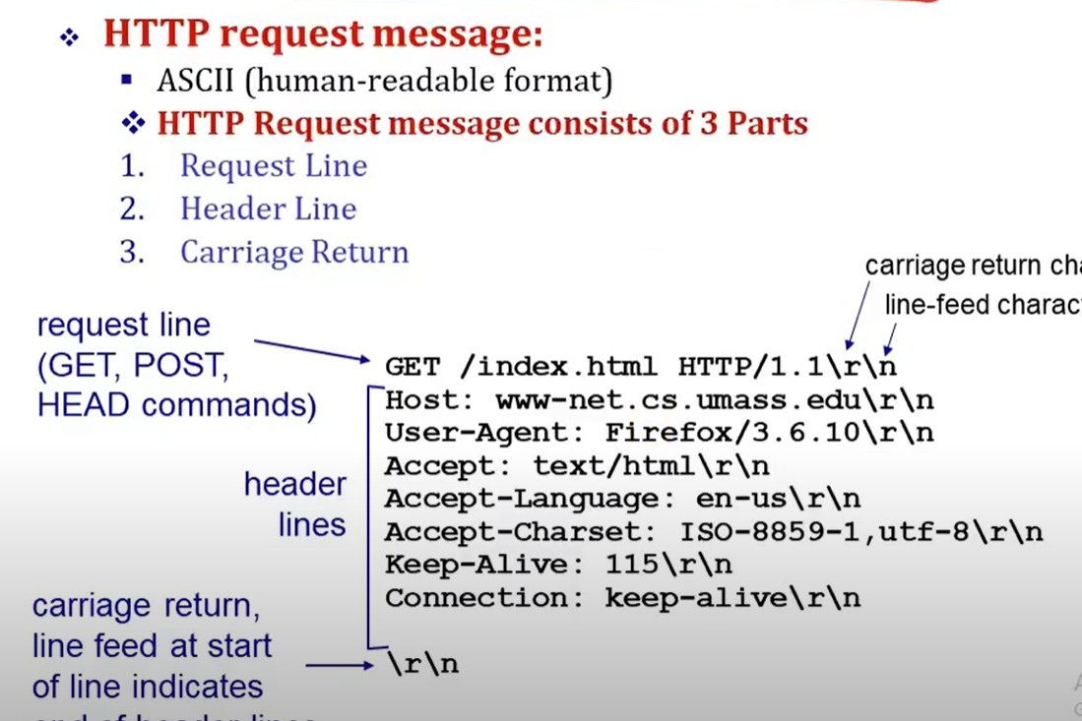

Slide 16
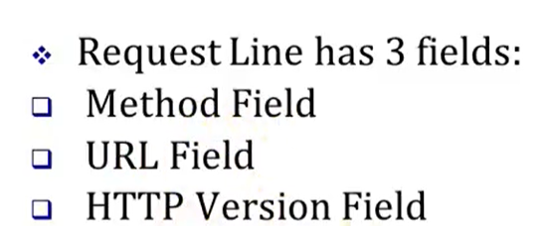
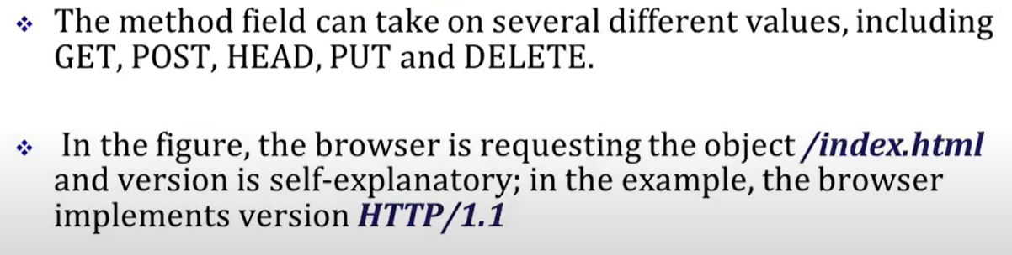

Slide 17
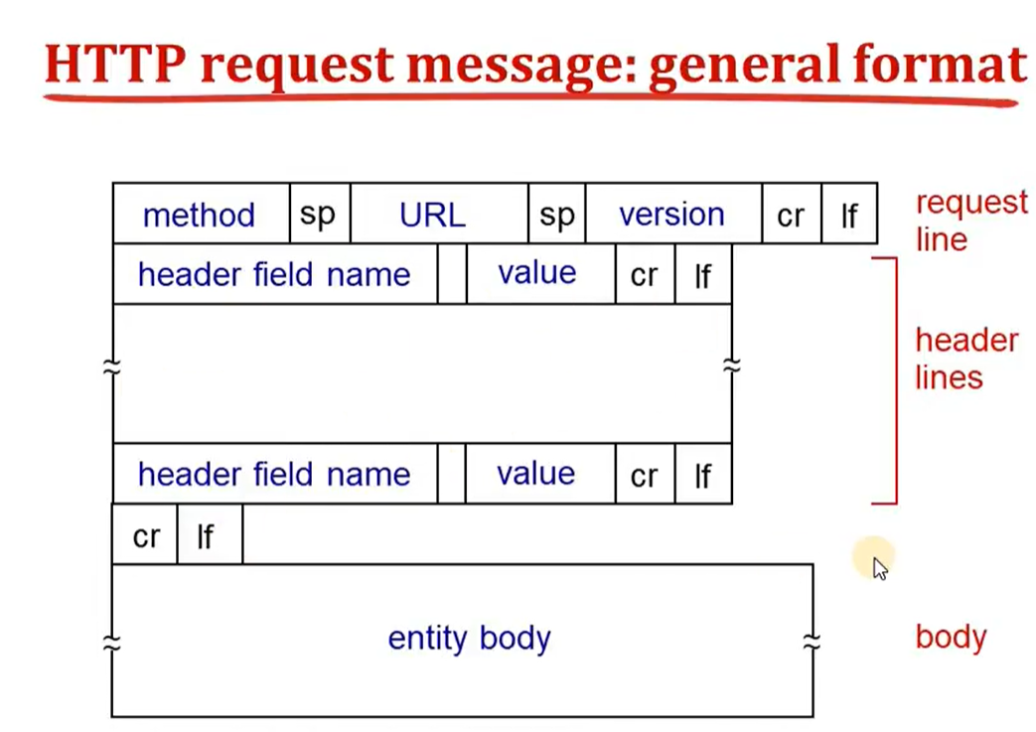

Slide 18
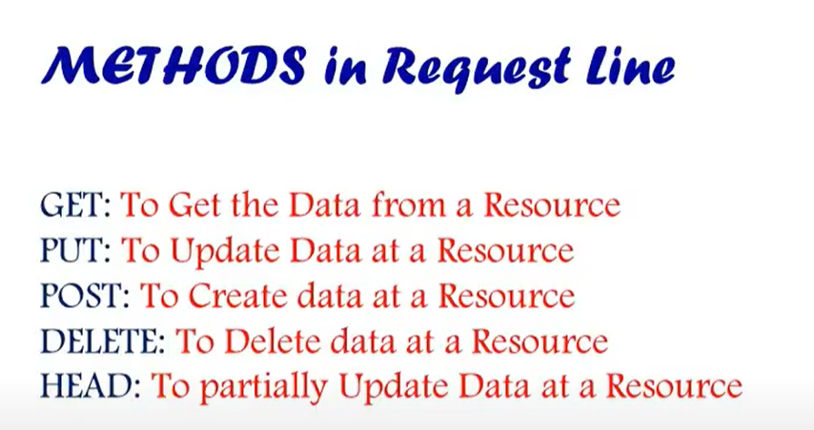

Slide 19
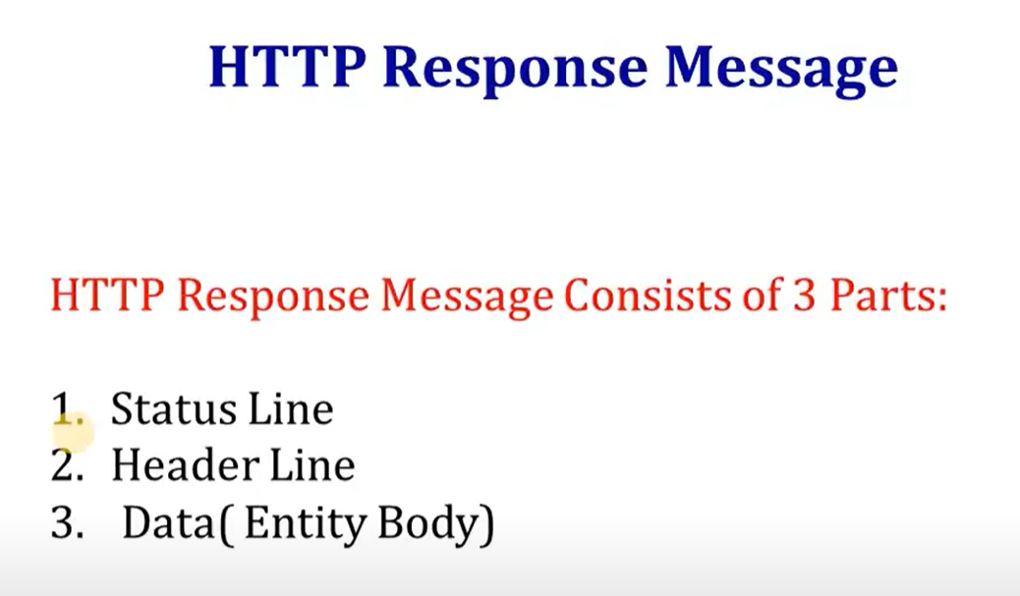

Slide 20
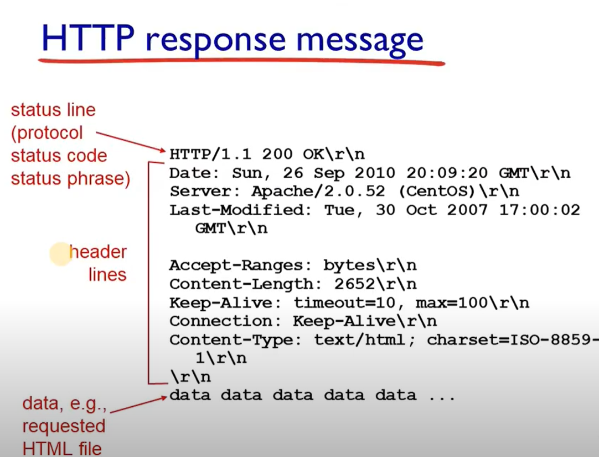

Slide 21
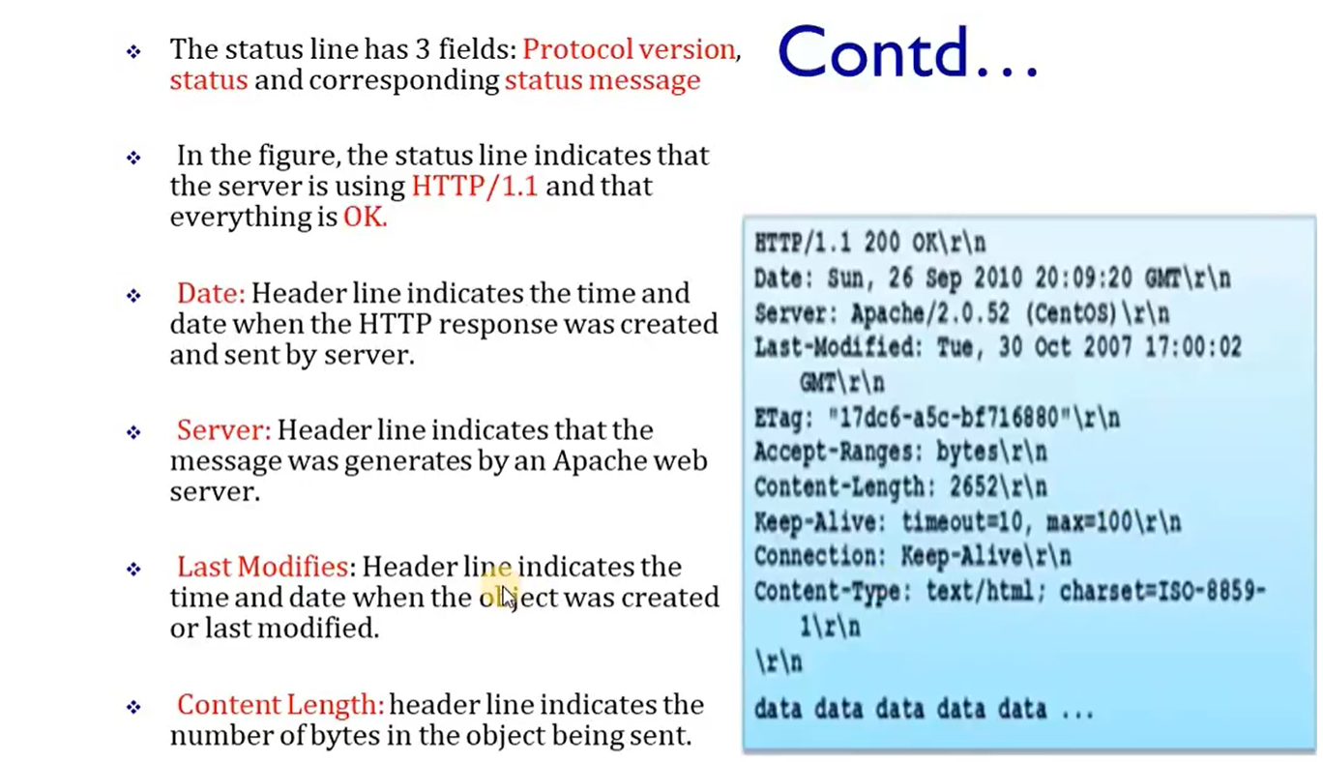

Slide 22
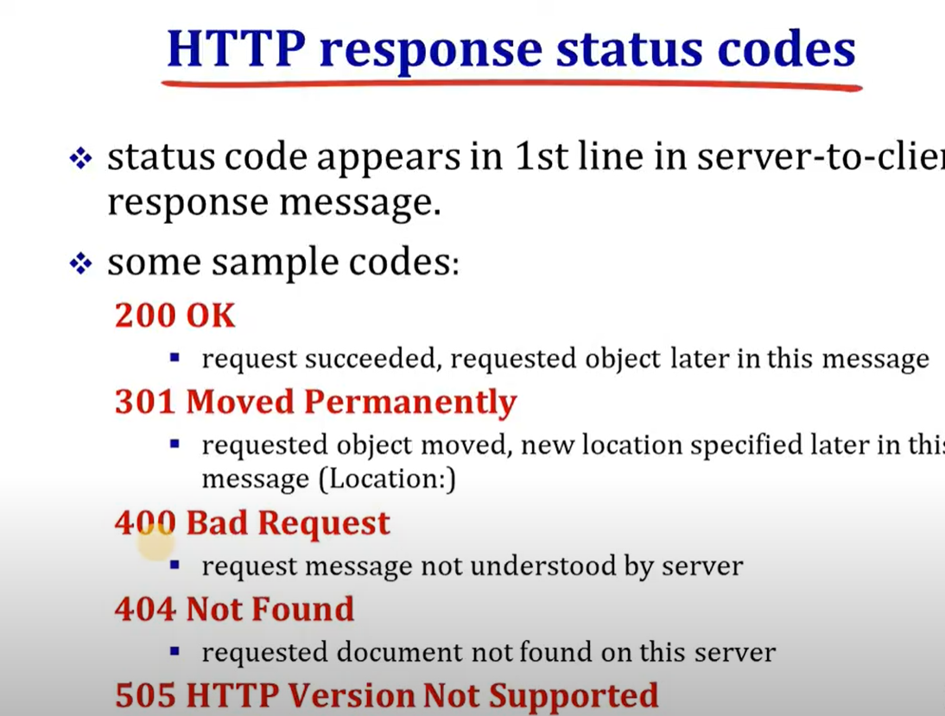

Slide 23
FTP Protocol
File Transfer Protocol(FTP) is an application layer protocol which moves files between local and remote file systems.
It runs on the top of TCP.
To transfer a file, 2 TCP connections are used by FTP in parallel: control connection and data connection.

Slide 24
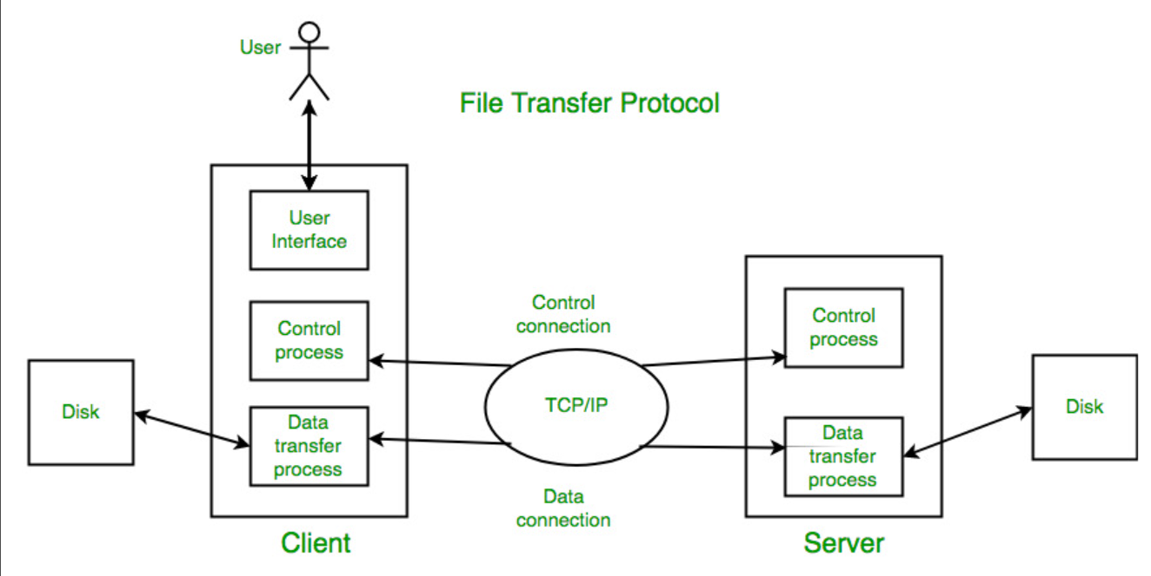

Slide 25
control connection For sending control information like user identification, password, commands to change the remote directory, commands to retrieve and store files, etc., FTP makes use of control connection.
The control connection is initiated on port number 21.
data connection For sending the actual file, FTP makes use of data connection. A data connection is initiated on port number 20. FTP sends the control information out-of-band as it uses a separate control connection.
Some protocols send their request and response header lines and the data in the same TCP connection.
For this reason, they are said to send their control information in-band. HTTP and SMTP are such examples.

Slide 26
FTP Session :
When a FTP session is started between a client and a server, the client initiates a control TCP connection with the server side.
The client sends control information over this. When the server receives this, it initiates a data connection to the client side.
Only one file can be sent over one data connection. But the control connection remains active throughout the user session.
As we know HTTP is stateless i.e. it does not have to keep track of any user state. But FTP needs to maintain a state about its user throughout the session.

Slide 27
Data Structures :
FTP allows three types of data structures :
File Structure – In file-structure there is no internal structure and the file is considered to be a continuous sequence of data bytes.
Record Structure – In record-structure the file is made up of sequential records.
Page Structure – In page-structure the file is made up of independent indexed pages.

Slide 28
FTP Commands – Some of the FTP commands are :
USER – This command sends the user identification to the server. PASS – This command sends the user password to the server. CWD – This command allows the user to work with a different directory or dataset for file storage or retrieval without altering his login or accounting information. RMD – This command causes the directory specified in the path-name to be removed as a directory. MKD – This command causes the directory specified in the pathname to be created as a directory. PWD – This command causes the name of the current working directory to be returned in the reply. RETR – This command causes the remote host to initiate a data connection and to send the requested file over the data connection. STOR – This command causes to store a file into the current directory of the remote host. LIST – Sends a request to display the list of all the files present in the directory. ABOR – This command tells the server to abort the previous FTP service command and any associated transfer of data. QUIT – This command terminates a USER and if file transfer is not in progress, the server closes the control connection.

Slide 29
FTP Replies – Some of the FTP replies are :
200 Command okay. 530 Not logged in. 331 User name okay, need a password. 225 Data connection open; no transfer in progress. 221 Service closing control connection. 551 Requested action aborted: page type unknown. 502 Command not implemented. 503 Bad sequence of commands. 504 Command not implemented for that parameter.

Slide 30
Electronic mail
At the beginning of the Internet era, the messages sent by electronic mail were short and consisted of text only
they let people exchange quick memos.
Today, electronic mail is much more complex.
It allows a message to include text, audio, and video. It also allows one message to be sent to one or more recipients.

Slide 31
Components of E-Mail System :
The basic components of an email system are :
User Agent (UA)
Message Transfer Agent (MTA)
Mail Box
Spool file.

Slide 32
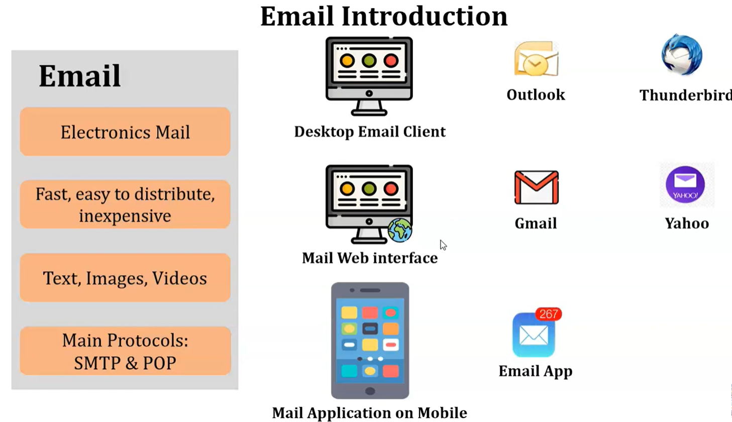

Slide 33
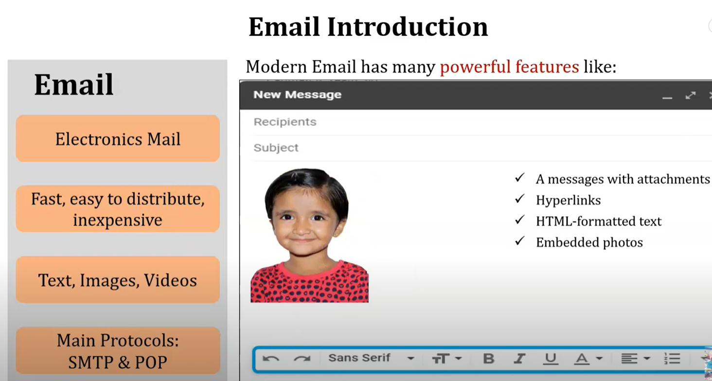

Slide 34
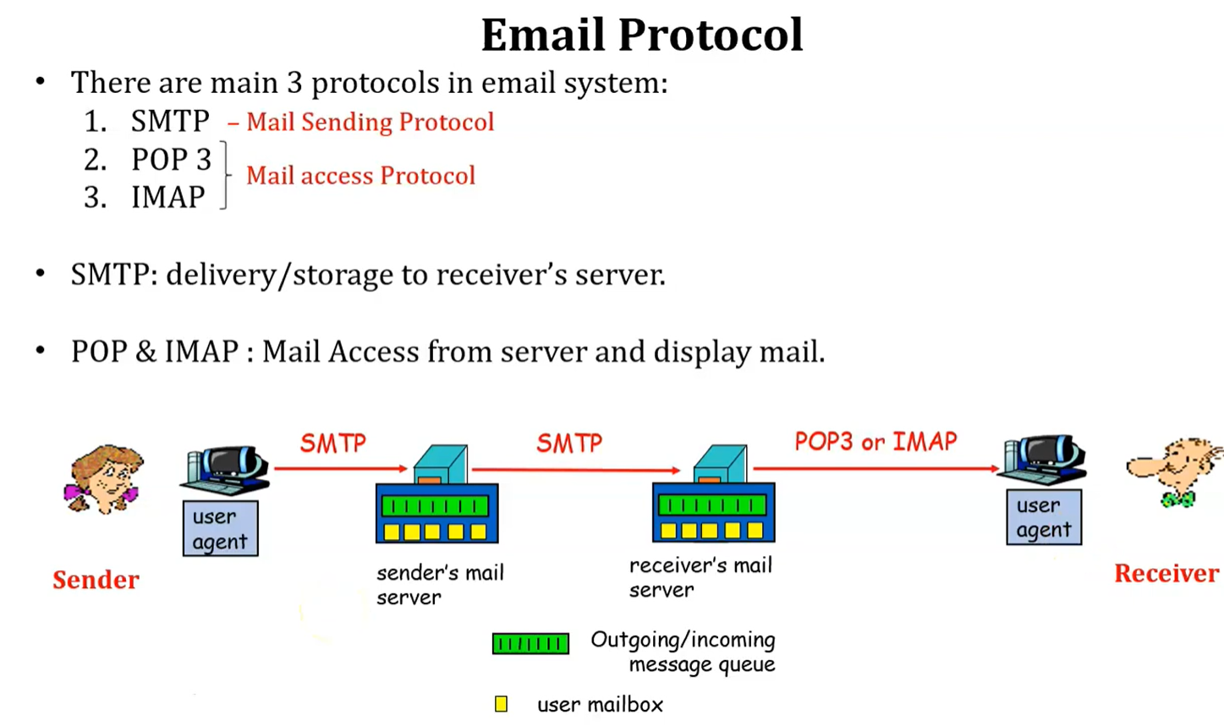

Slide 35
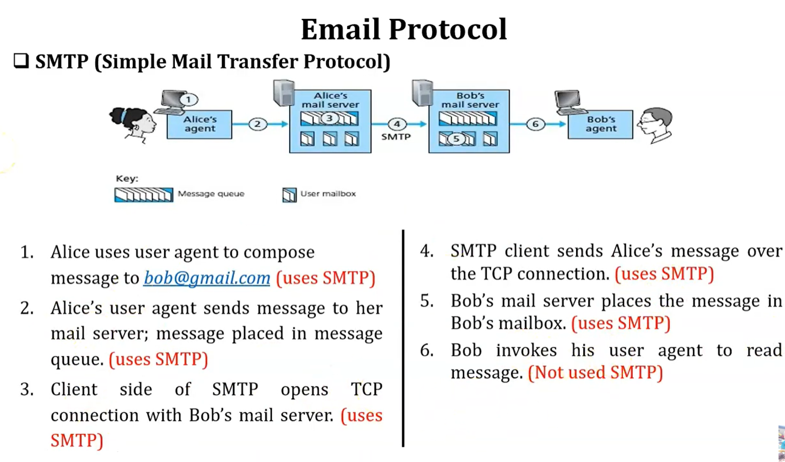

Slide 36
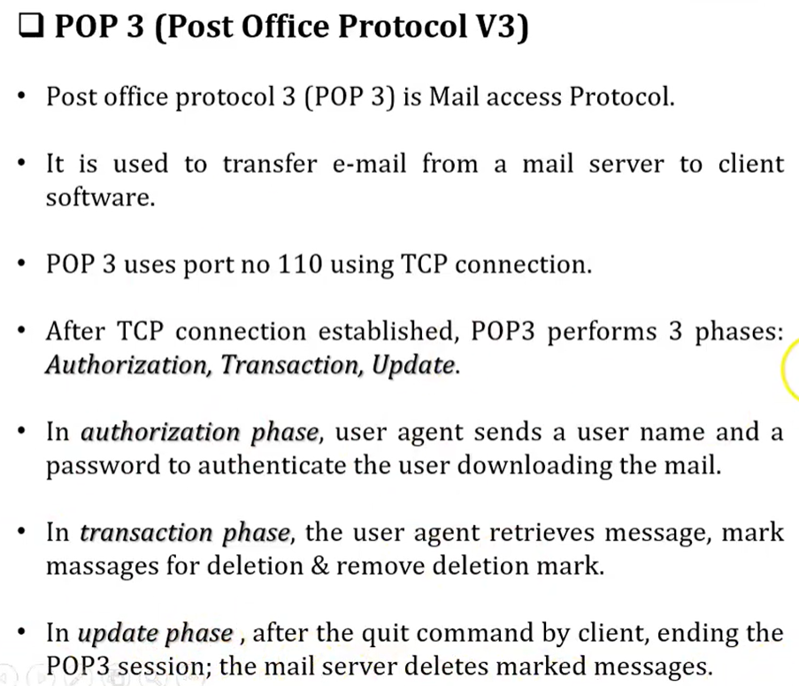
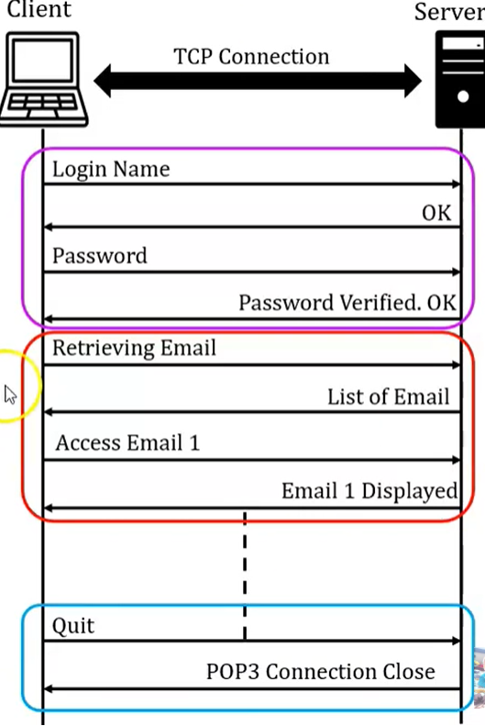

Slide 37
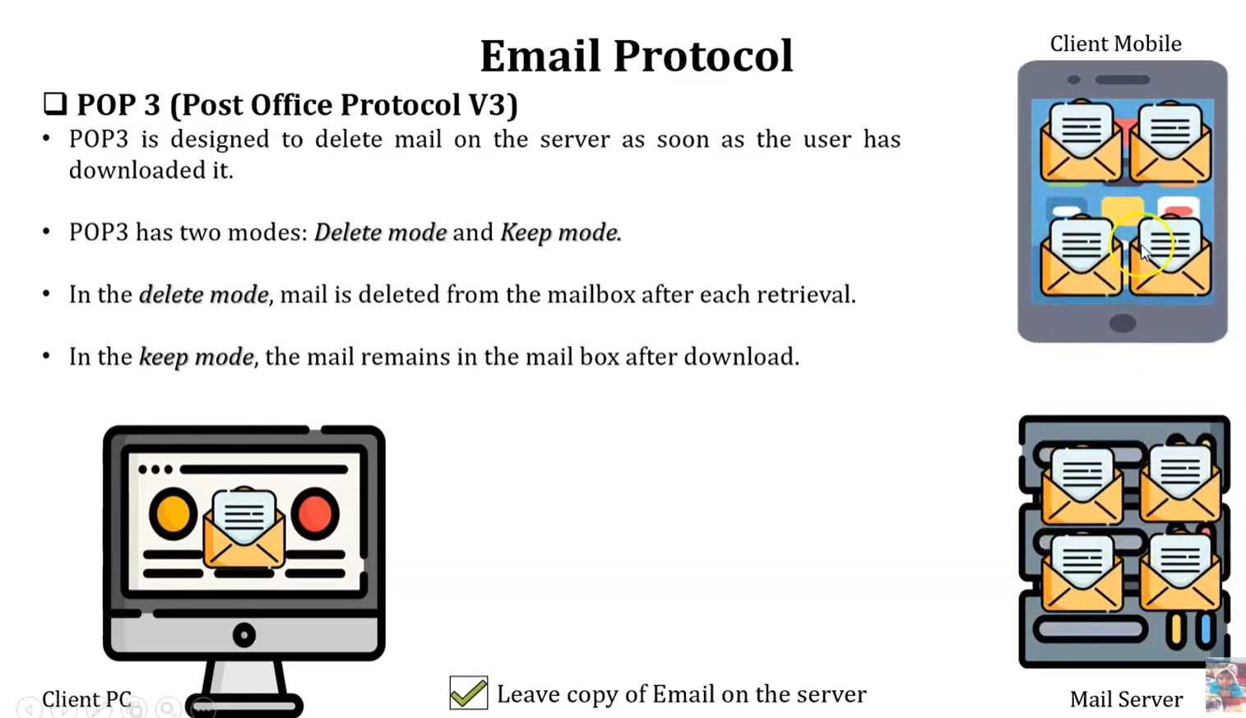

Slide 38
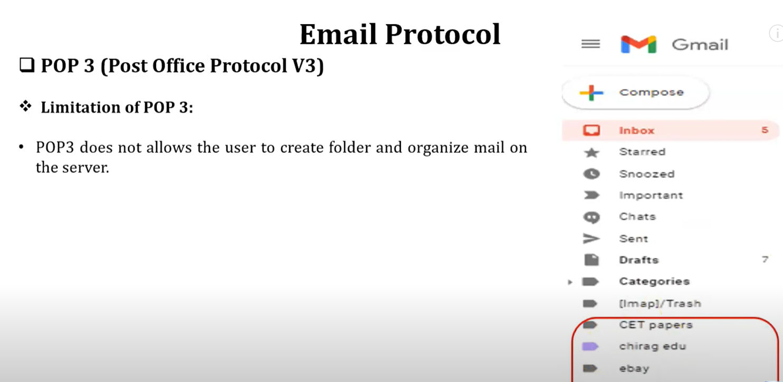

Slide 39
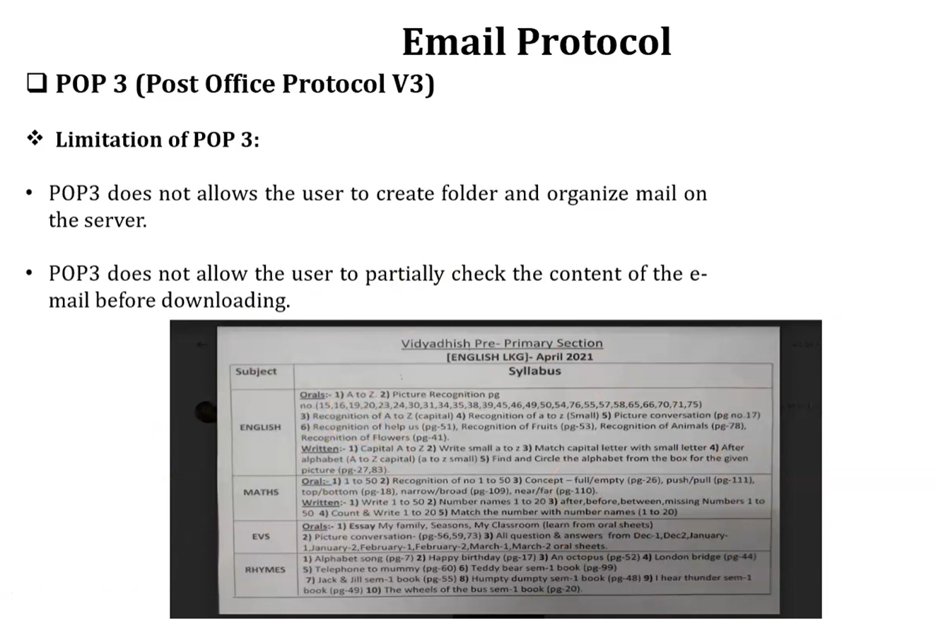

Slide 40
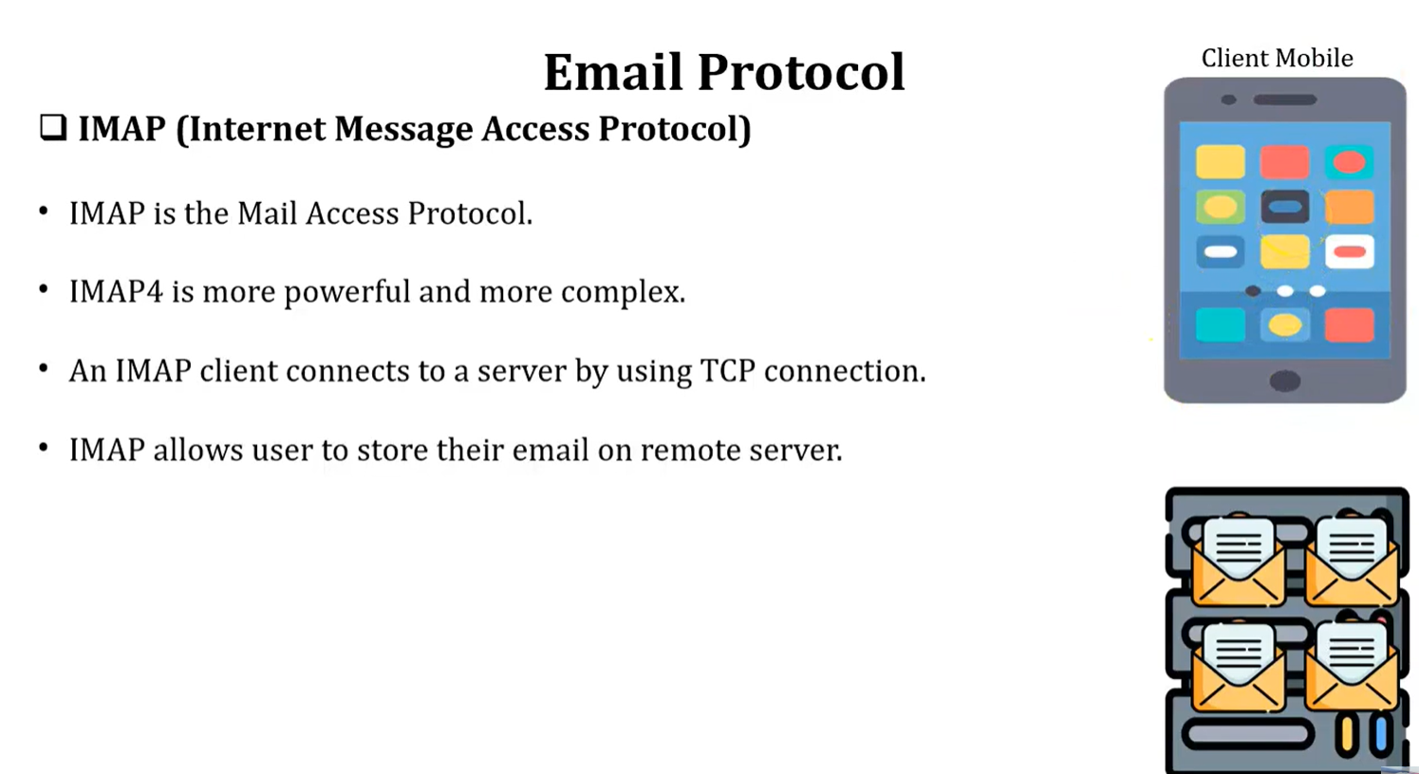

Slide 41
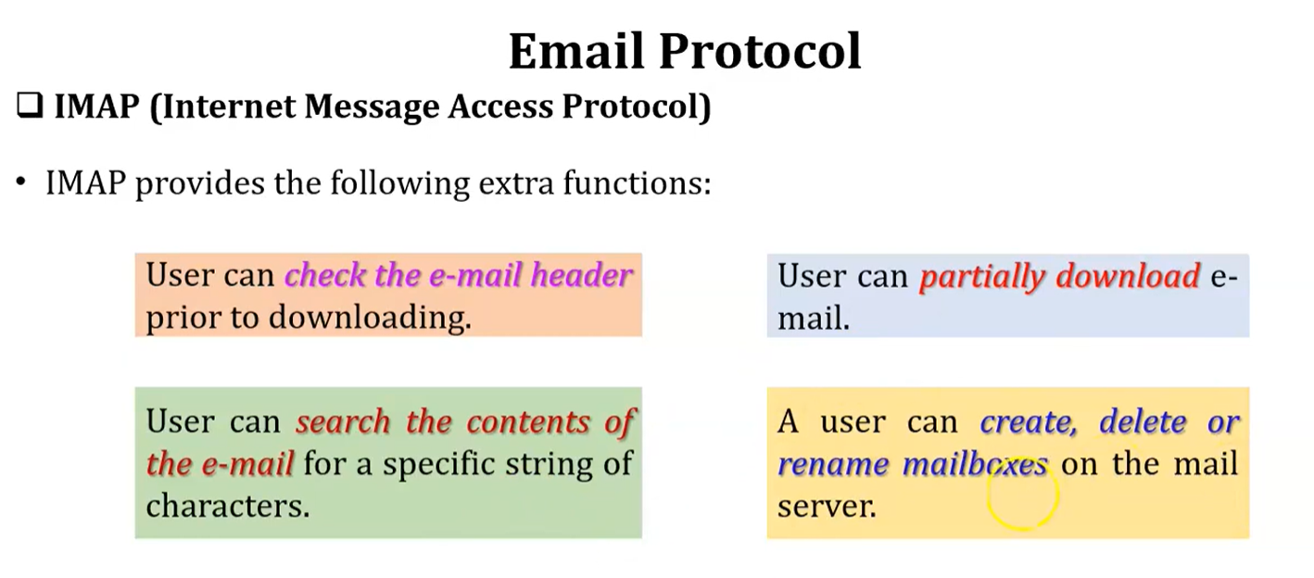

Slide 42
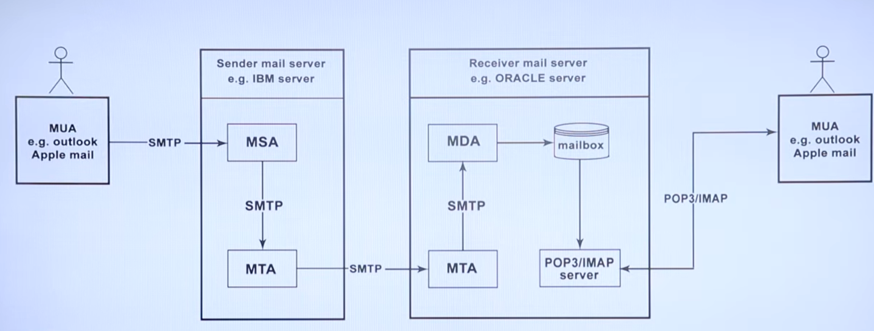

Slide 43
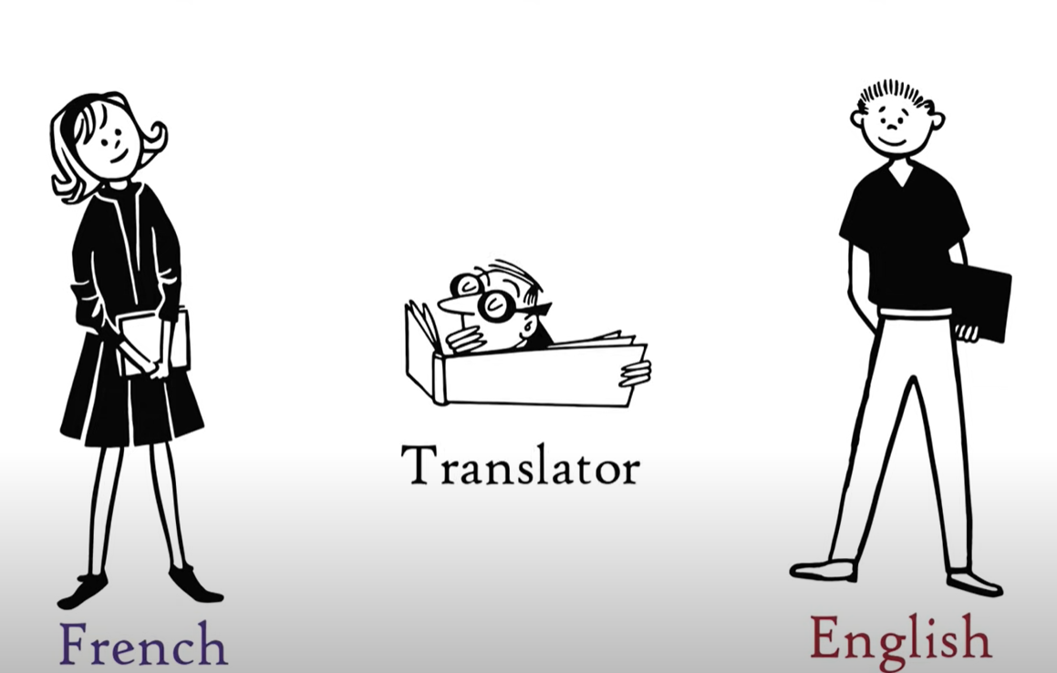
DNS

Slide 44
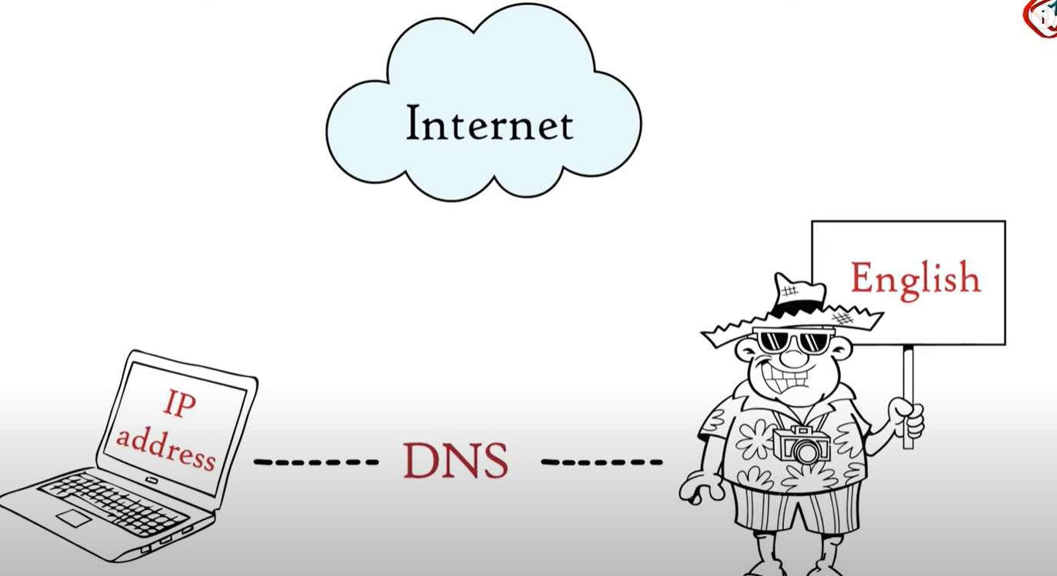

Slide 45
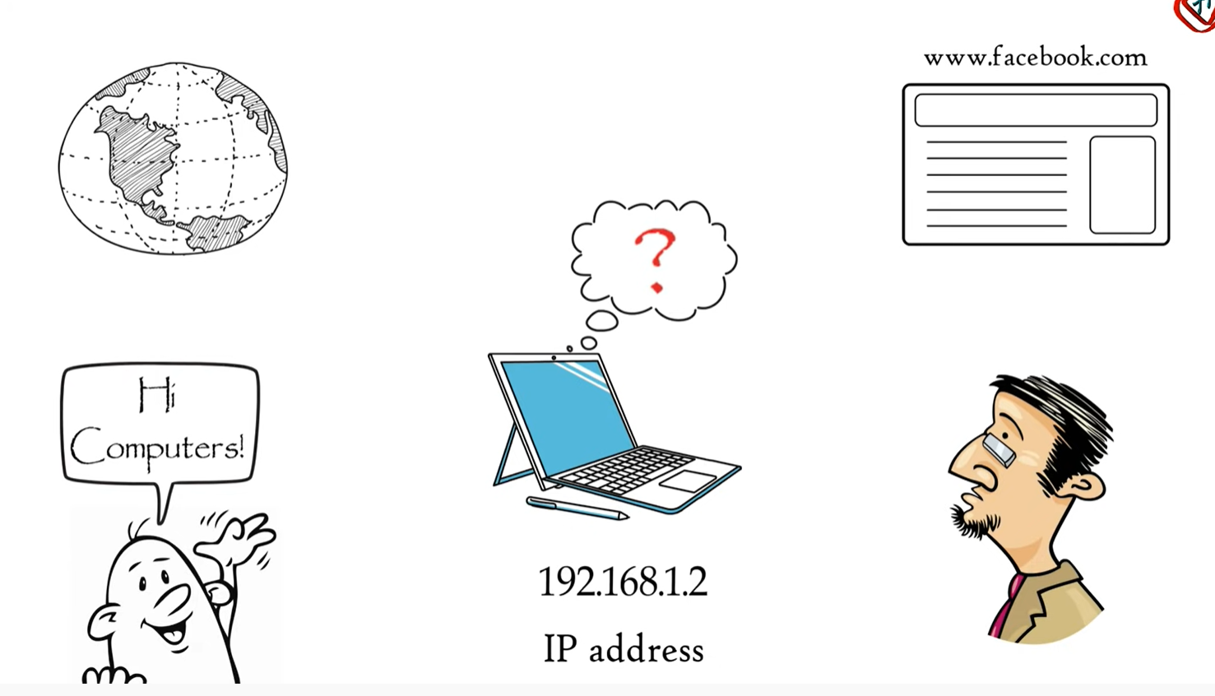

Slide 46
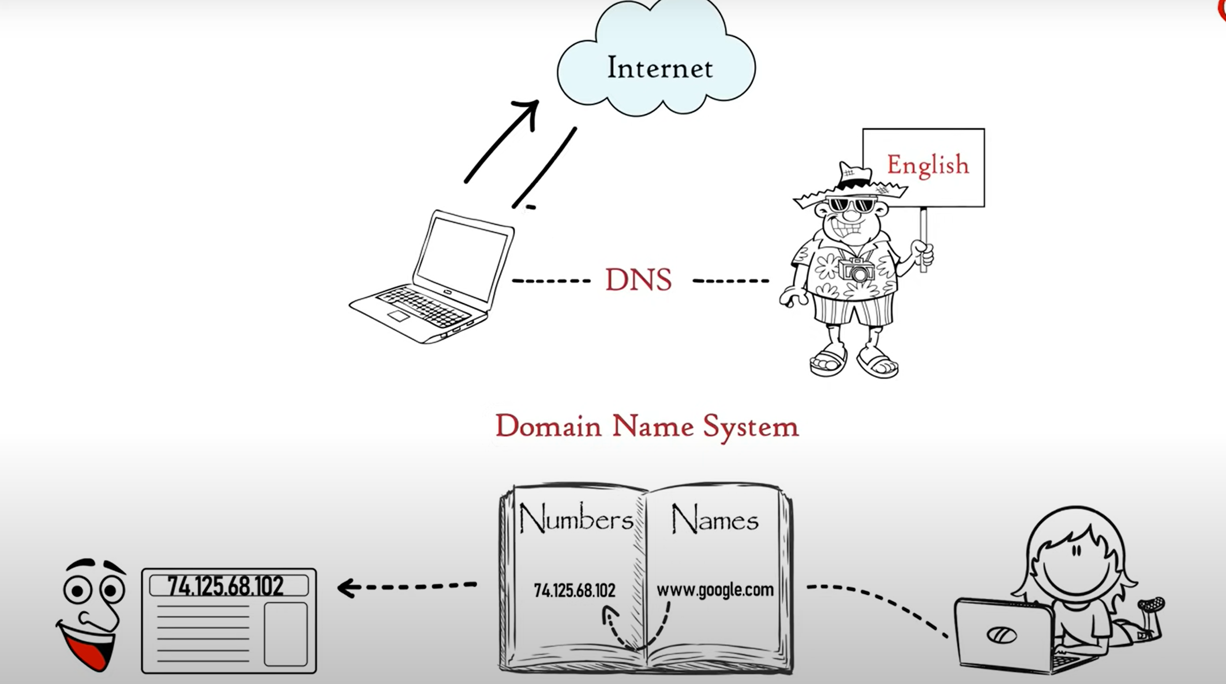

Slide 47
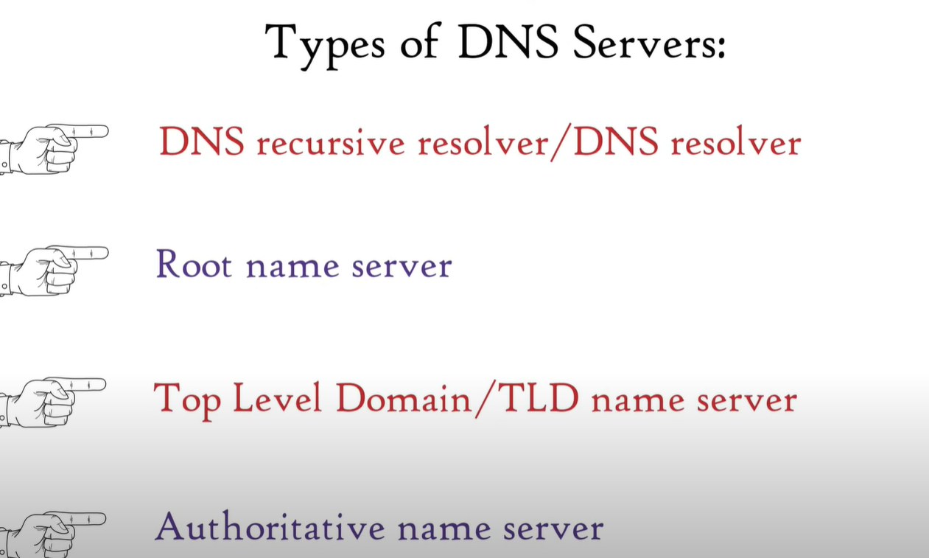

Slide 48
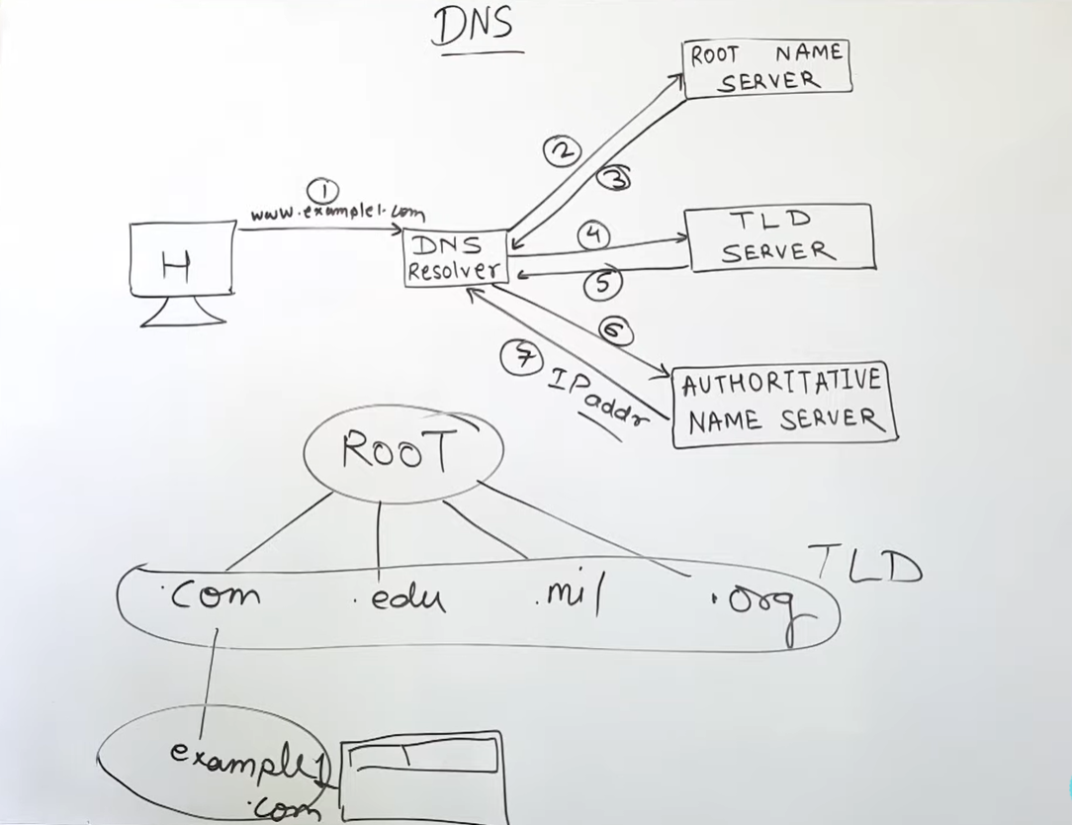

Slide 49
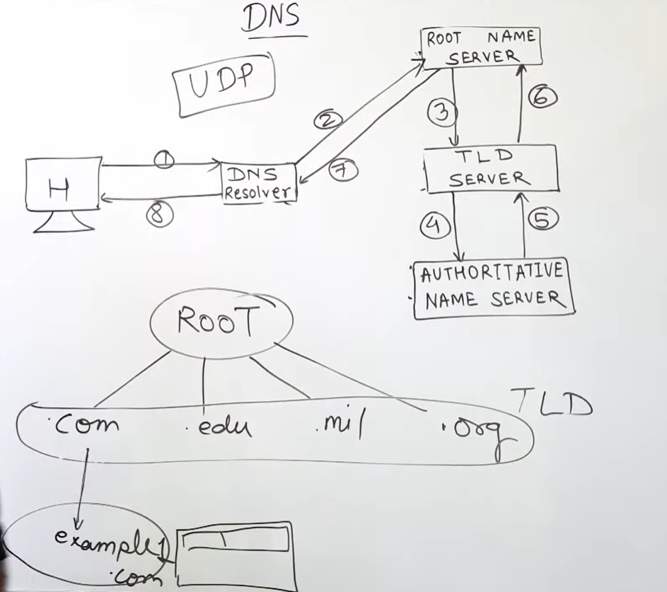

Slide 50
SNMP
Simple Network Management Protocol (SNMP) – SNMP is an application layer protocol that uses UDP port number 161/162.SNMP is used to monitor the network, detect network faults, and sometimes even used to configure remote devices.
SNMP components – There are 3 components of SNMP:
SNMP Manager – It is a centralized system used to monitor network. It is also known as Network Management Station (NMS)
SNMP agent – It is a software management software module installed on a managed device. Managed devices can be network devices like PC, routers, switches, servers, etc.

Slide 51
Management Information Base – MIB consists of information of resources that are to be managed.

Slide 52
SNMP messages – Different variables are:
GetRequest – SNMP manager sends this message to request data from the SNMP agent. It is simply used to retrieve data from SNMP agents. In response to this, the SNMP agent responds with the requested value through a response message.
GetNextRequest – This message can be sent to discover what data is available on an SNMP agent. The SNMP manager can request data continuously until no more data is left. In this way, the SNMP manager can take knowledge of all the available data on SNMP agents.

Slide 53
3.GetBulkRequest – This message is used to retrieve large data at once by the SNMP manager from the SNMP agent. It is introduced in SNMPv2c.
4.SetRequest – It is used by the SNMP manager to set the value of an object instance on the SNMP agent.
5.Response – It is a message sent from the agent upon a request from the manager. When sent in response to Get messages, it will contain the data requested. When sent in response to the Set message, it will contain the newly set value as confirmation that the value has been set.

Slide 54
6.Trap – These are the message sent by the agent without being requested by the manager. It is sent when a fault has occurred.
7.InformRequest – It was introduced in SNMPv2c, used to identify if the trap message has been received by the manager or not. The agents can be configured to set trap continuously until it receives an Inform message. It is the same as a trap but adds an acknowledgement that the trap doesn’t provide.

Slide 55
Presentation layer
Compression: Comparison between Lossy Compression and Lossless Compression
Huffman Coding
Speech Compression
LZW
RLE
Image Compression – GIF,JPEG

Slide 56
The presentation layer is layer 6 of the 7-layer Open Systems Interconnection (OSI) model. It is used to present data to the application layer (layer 7) in an accurate, well-defined and standardized format.
Functions of Presentation Layer
Translation: Before being transmitted, information in the form of characters and numbers should be changed to bit streams. The presentation layer is responsible for interoperability between encoding methods as different computers use different encoding methods. It translates data between the formats the network requires and the format the computer.

Slide 57
2.Encryption: It carries out encryption at the transmitter and decryption at the receiver.
3.Compression: It carries out data compression to reduce the bandwidth of the data to be transmitted. The primary role of Data compression is to reduce the number of bits to be transmitted. It is important in transmitting multimedia such as audio, video, text etc.

Slide 58
Data Compression refers to a technique where a large file to reduced to smaller sized file and can be decompressed again to the large file.
Lossy compression restores the large file to its original form with loss of some data which can be considered as not-noticable while lossless compression restores the large file to its original form without any loss of data.
Following are some of the important differences between Lossy Compression and Lossless Compression.

Slide 59
Sr. No. | Key | Lossy Compression | Lossless Compression
1 | Data Elimination | Lossy compression eliminates those bytes which are considered as not-noticable. | Lossless compression keeps even those bytes which are not-noticable.
2 | Restoration | After lossy compression, a file cannot be restored to its original form. | After lossless compression, a file can be restored to its original form.
3 | Quality | Lossy compression leads to compromise with quality. | No quality degradation happens in lossless compression.

Slide 60
4 | Size | Lossy compression reduces the size of file to large extent. | Lossless compression reduces the size but less as compared to lossy compression.
5 | Algorithm used | Transform coding, Discrete Cosine Transform, Discrete Wavelet transform, fractal compression etc. | Run length encoding, Lempel-Ziv-Welch, Huffman Coding, Arithmetic encoding etc.
6 | Uses | Lossy compression is used to compress audio, video and images. | Lossless compression is used to compress text, images and sound.
7 | Capacity | Lossy compression technique has high data holding capacity. | Lossless compression has low data holding capacity as compared to lossy compression.

Slide 61
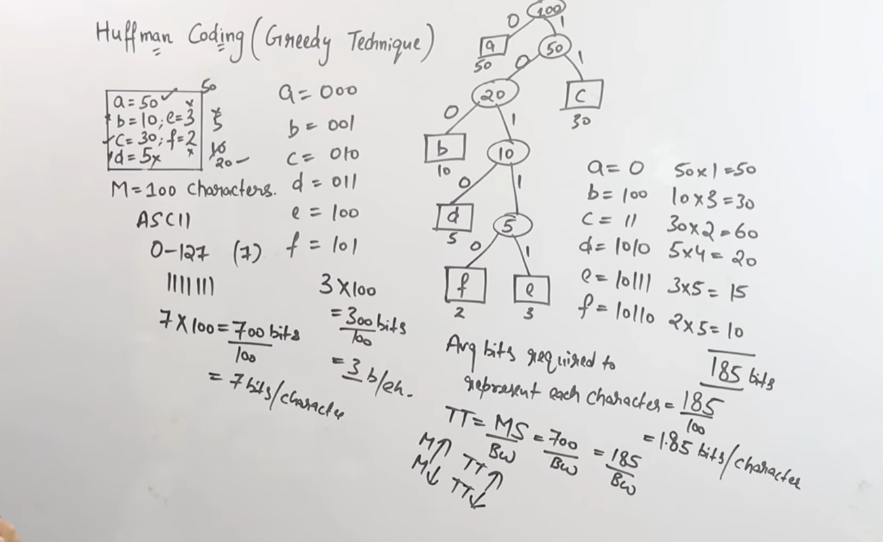

Slide 62


Slide 63
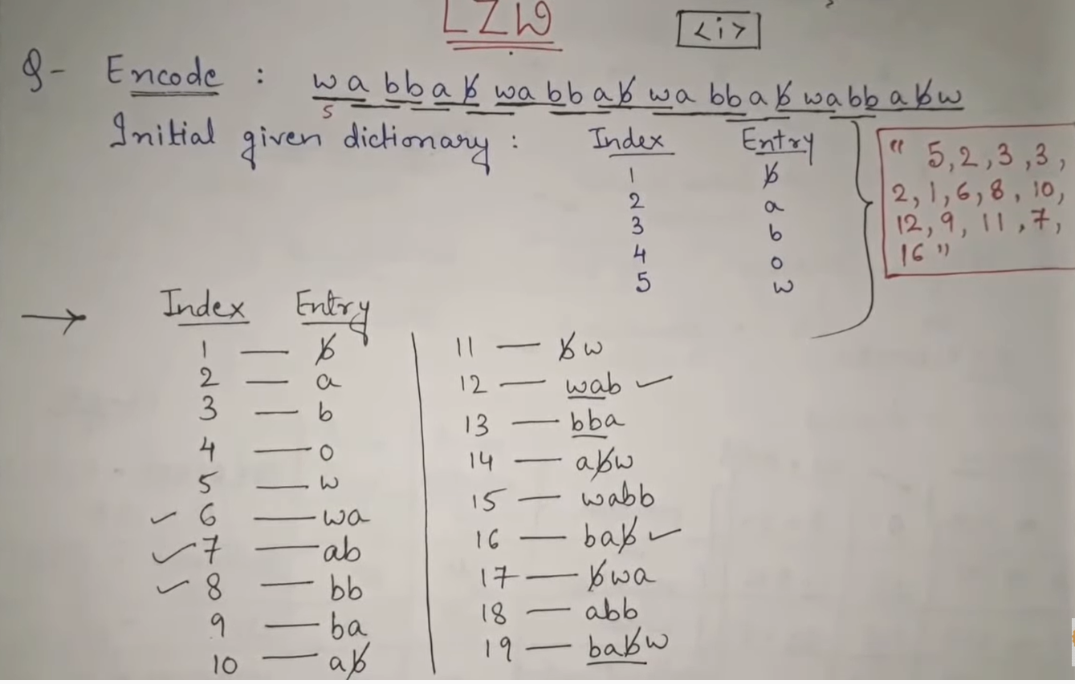
LZW

Slide 64
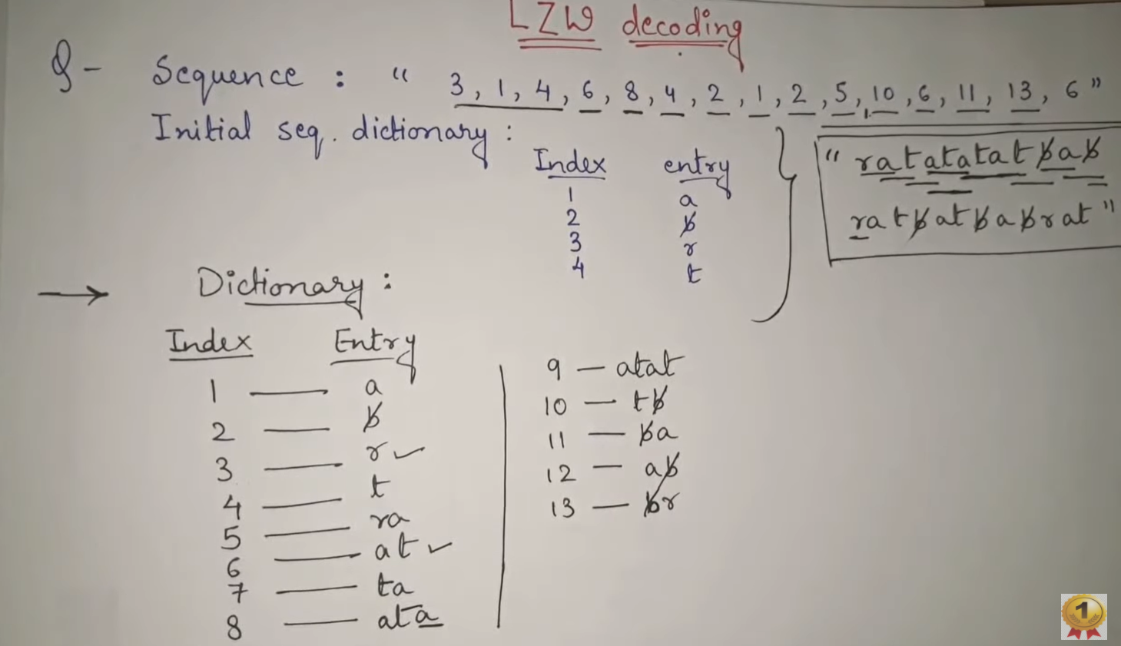

Slide 65

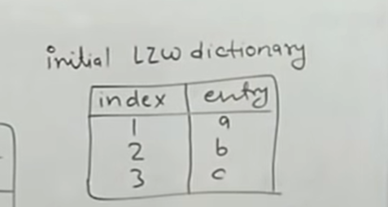
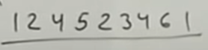

Slide 66
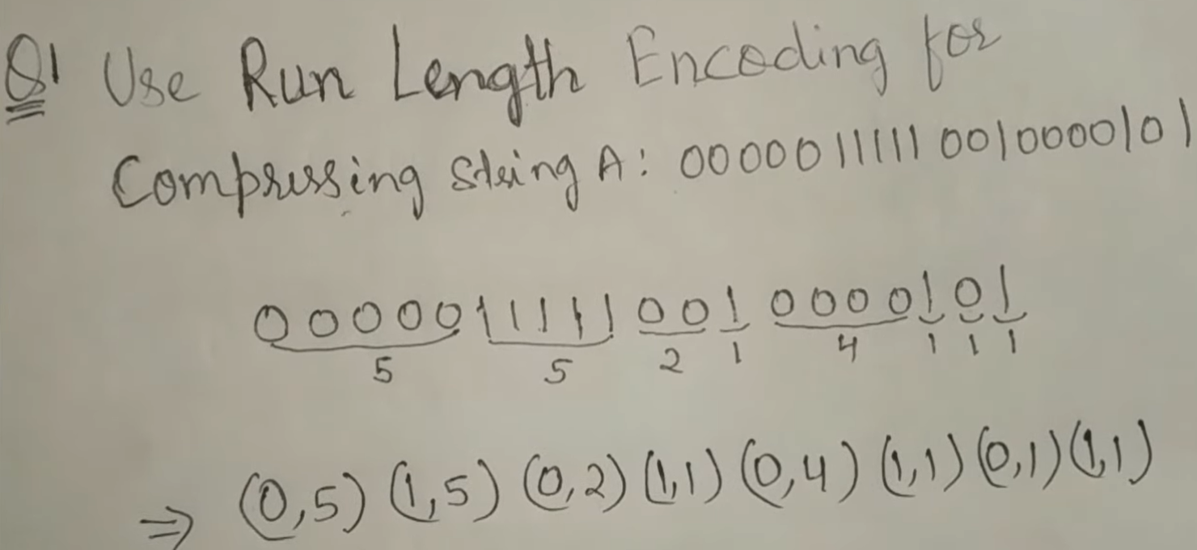
RLE

Slide 67
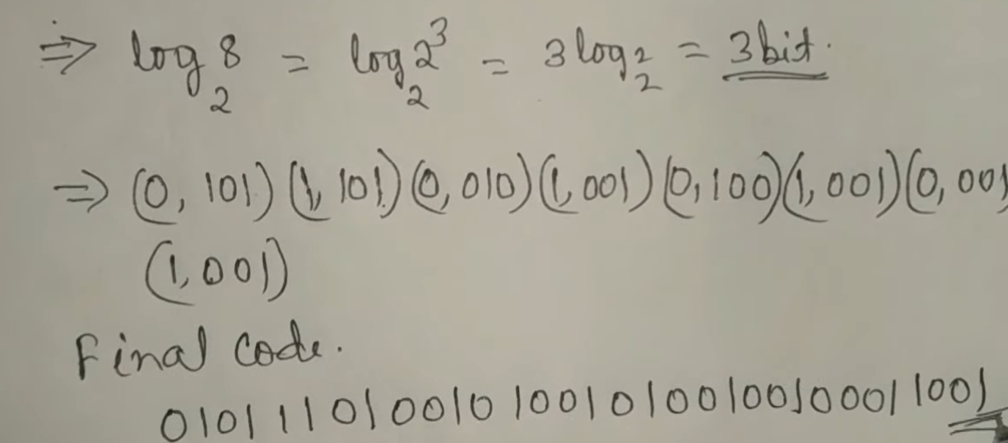

Slide 69
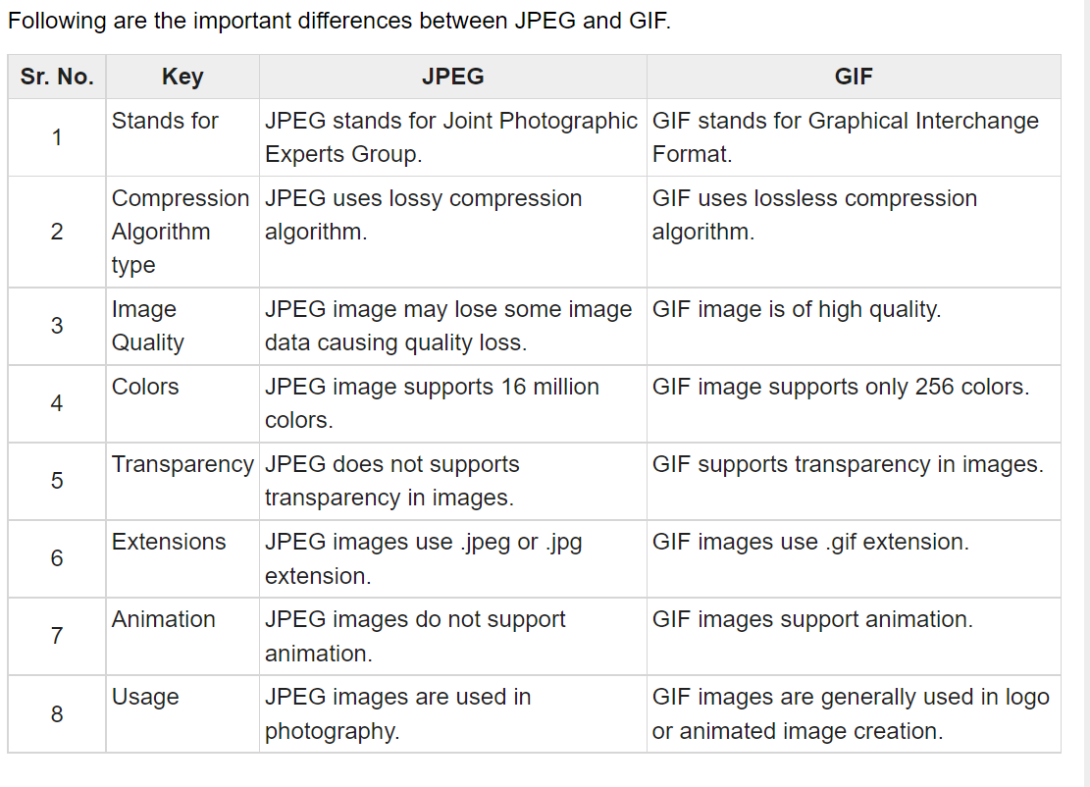
Image Compression – GIF,JPEG
.

Slide 70
Thankyou

